Slide 1

INTRO
^{Welcome} to the Neuroscience of the Co-Active Model!

Slide 2
The brain is a monstrous, beautiful mess. Its billions of nerve cells - called neurons - lie in a tangled web that displays cognitive powers far exceeding any of the silicon machines we have built to mimic it.
~William F. Allman

Slide 3
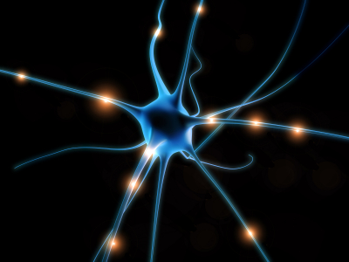
^{CTI | CO-ACTIVE COACHING}
Session One ~ 9/25
The Importance of Co-Active
and Integration
Session Two ~ 10/2
The Four Cornerstones
and Neuroplasticity
Session Three ~ 10/9
The Three Principles
and the Pre-Frontal Cortex
Session Four ~ 10/16
The Five Contexts and the
Social and Interconnected Brain
Series Overview

Slide 4

^{CTI | CO-ACTIVE COACHING}
Information & Logistics
~ Feel free to write in questions or comments throughout the session, and we will answer as many as possible during the Q & A times.
~ You’ll receive an email with suggested pre-work and homework before each session.
~ There is a closed Facebook group set up for discussion: Neuroscience and Co-Active Coaching Discussion – pre- work and homework will be posted here as well.
~ Recordings will be available at: http://www.thecoaches.com/webinar-access/loginWA.php within 72 hours. A copy of each week’s slides will also be accessible to everyone through the same website after the call.

Slide 5
^{CTI | CO-ACTIVE COACHING}
Session #1
The Critical Importance of Being Co-Active
BRAIN CONCEPT: Integration
The impact of integration on the brain and overall effectiveness
How Co-Active coaching helps the brain connect with itself
New tool for intentional brain integration

Slide 6
Do I contradict myself?
Very well then I contradict myself,
(I am large, I contain multitudes.)
~Walt Whitman

Slide 7

^{CTI | CO-ACTIVE COACHING}
Definition of Integration:
The linkage of differentiated parts
~Dr. Daniel Siegel

Slide 8
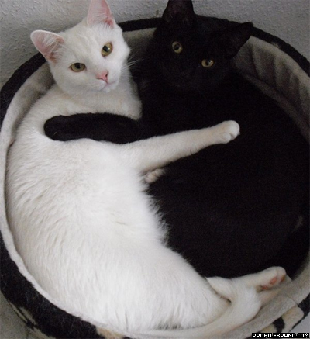
^{CTI | CO-ACTIVE COACHING}
What are we Integrating?
Right and Left Hemisphere
Higher and Lower Brains
Multiple Aspects of our Selves
Information from our Heart and Gut Brains
CO and ACTIVE

Slide 9
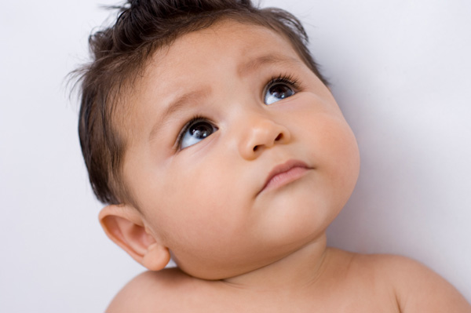
^{CTI | CO-ACTIVE COACHING}
Q & A

Slide 10
The intuitive mind is a sacred gift and
the rational mind is a faithful servant.
We have created a society that honors the servant and has forgotten the gift.
~Albert Einstein

Slide 11
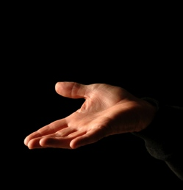
On the one hand….
On the one hand…..

Slide 12
^{CTI | CO-ACTIVE COACHING}
LEFT
One-point focus
Specificity; narrows things down
Language and logic
Separateness
Explicit
Filters out information Sequences and plans
Usefulness
Positivity
RIGHT
Holistic
Big Picture
Metaphor
Information from the body
Oneness/interconnection
Implicit
Takes in much of the information available
Present moment
Purpose and meaning
The two hemispheres of the brain play important roles,
and we need them both for maximum effectiveness

Slide 13
On the other hand….
On the other hand…..

Slide 14
^{CTI | CO-ACTIVE COACHING}
LEFT
RIGIDITY
Blame
Anger
Sees people as things
Misses the point
RIGHT
CHAOS
Overwhelm
Anxiety
Depression
Hopelessness
Each hemisphere has its own less effective tendencies
when in reactive mode

Slide 15

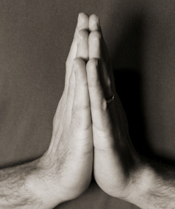
^{CTI | CO-ACTIVE COACHING}
In the Effective Brain
each hemisphere is able to link with the positive aspects of the other hemisphere as is helpful
as well as inhibit the other hemisphere’s reactive tendencies and/or over-calibration

Slide 16
^{CTI | CO-ACTIVE COACHING}
Co-Active – a metaphor
for the two hemispheres
RH = CO
LH = ACTIVE
Hyphen is integration
as well as inhibition

Slide 17
^{CTI | CO-ACTIVE COACHING}
LEFT
RIGHT
STRUCTURE
FOCUS
DIRECTION
POSITIVITY
FREEDOM
ONENESS
MEANING
PRESENT MOMENT
RIGIDITY
ANGER
BLAME
DENIAL
CHAOS
OVERWHELM
DEPRESSION
FEAR

Slide 18
^{CTI | CO-ACTIVE COACHING}
RH / LH Integration Tool—
the DIAGONAL PROCESS
Notice where your client is coming from ~
is it CHAOS or RIGIDITY?
Go “diagonal” above
If they are more in CHAOS, work on structure and focus
If they are more in RIGIDITY, work on purpose and meaning

Slide 19
^{CTI | CO-ACTIVE COACHING}
LEFT
RIGHT
STRUCTURE
FOCUS
DIRECTION
POSITIVITY
FREEDOM
ONENESS
MEANING
PRESENT MOMENT
RIGIDITY
ANGER
BLAME
DENIAL
CHAOS
OVERWHELM
DEPRESSION
FEAR

Slide 20

^{CTI | CO-ACTIVE COACHING}
Q & A

Slide 21
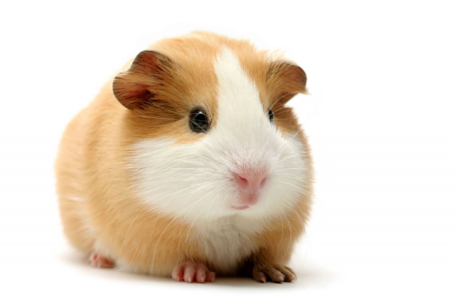
^{CTI | CO-ACTIVE COACHING}
HOMEWORK
Use Diagonal Process with a coaching client and post your results and learning to the Facebook group.
Notice your Right and Left Hemispheres in both creative and reactive mode. What takes you to Chaos? What takes you to Rigidity?
If you lean in to the other hemisphere when you are reactive, how is that helpful? Post to FB group.
Life is a joyous experiment. Be your own guinea pig.

Slide 22


^{CTI | CO-ACTIVE COACHING}
^{FOR MORE INFORMATION}
1.800.691.6008 opt. 3 | 415.451.6000 opt. 3 | info@thecoaches.com

